Slide 1
How to use the Saab Powerpoint template
This template have been created to deliver a consistent Saab message to all audiences
It only uses Arial font, standard with Office
Consider the audience and environment when choosing slide variation. For instance, dark backgrounds may work well for conference presentations, but are not ideal for corporate or printing purposes
The template suggests font usage, type size for headlines and bullets, and layouts for charts and graphs
The template offers:
16:9 aspect ratio
Various title slides
Various chapter slides
Layout options including quote slides, slides for content and graph/data/picture/film
A variety of Saab colors

Slide 2
DevOps
Visualizing Smoke test
Challenges - Effect
Ingela Persson, Malcom Bagger Toräng and Gustaf Lidfeldt
October 14, 2019
9LVPP, C2S, Surveillance, Saab AB
Notes:
Instructions how to use the Saab Powerpoint template
This template have been created to deliver a consistent Saab message to all audiences. It only uses Arial font, standard with Microsoft Office.
This Powerpoint template offers:
16:9 aspect ratio (widescreen size compatible with HD monitors)
Various title slides
Various chapter slides
Layout options including quote slides, slides for content and graph/data/picture/film
A variety of Saab colors
Consider the audience and environment when choosing slide variation. For instance, dark backgrounds may work well for conference presentations, but are not ideal for corporate or printing purposes.
The template suggests font usage, type size for headlines and bullets, and layouts for charts and graphs.

Slide 3
Goal
”To visualize Smoketest”

Slide 4
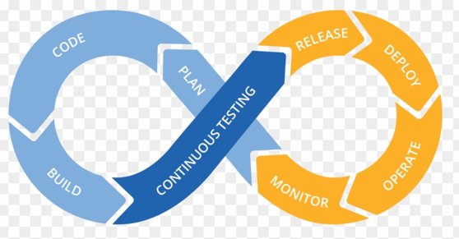
DevOps
Smoke
Test
Notes:
Where are we with smoke test vs. DevOps

Slide 5
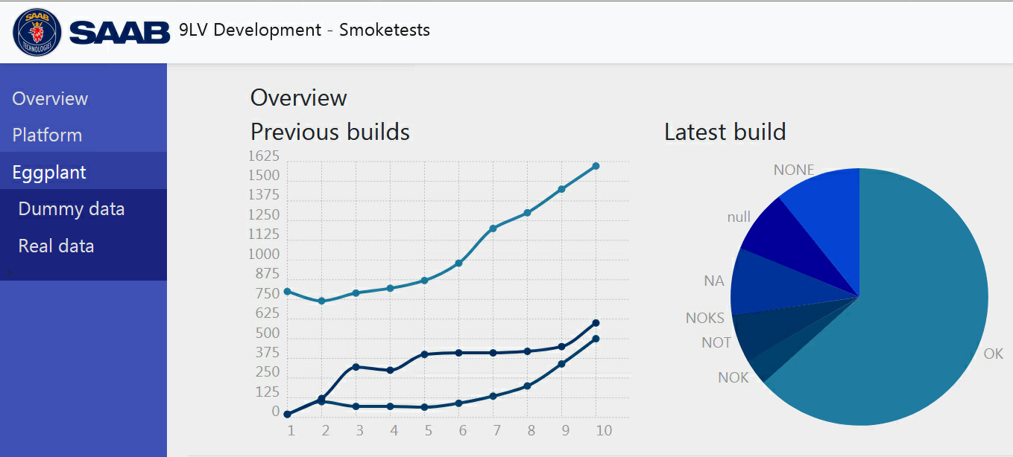
Result
Notes:
To show proof of Concept

Slide 6
Challanges
Culture
Access
VM
Visualize
Notes:
Areas of challanges

Slide 7
Effect
Notes:
What you see you can act on

Slide 8
Effect
Can we…
Can we..
Notes:
What you see you can act on

Slide 9
Effect
Pipeline
Notes:
What you see you can act on

Slide 10
Pipeline
OPS
DEV
SUT
Notes:
Where are we with smoke test vs. DevOps

Slide 11
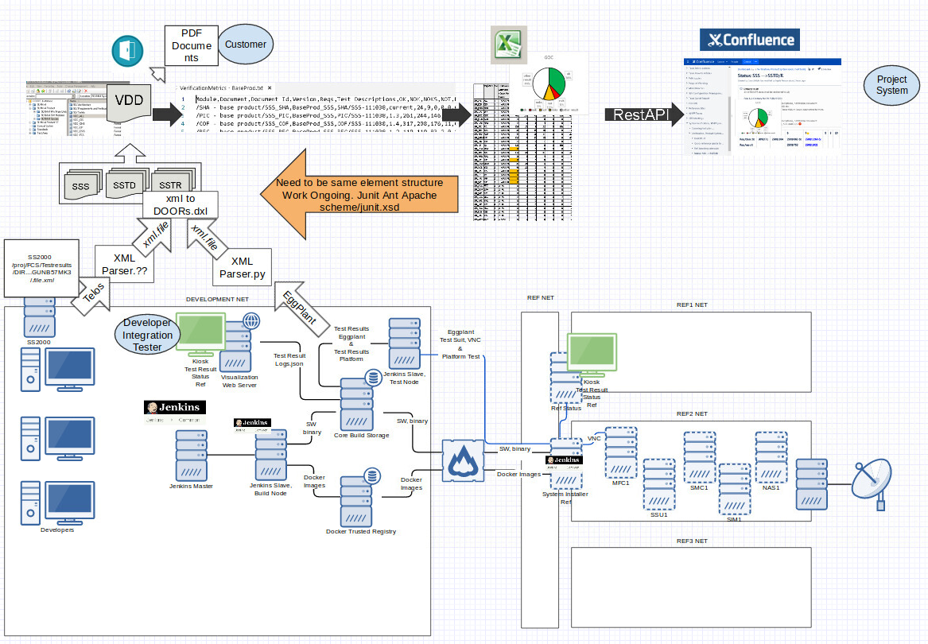
Pipeline
OPS
DEV
SUT
Notes:
Where are we with smoke test vs. DevOps

Slide 12
Pipeline
OPS
DEV
Notes:
Where are we with smoke test vs. DevOps

Slide 13
Thanks
Ingela Persson, Malcom Bagger Toräng, Gustaf Lidfeldt, Surveillance Saab AB

