Slide 1
A Holistic Approach for Effective Error Detection
Ziawasch Abedjan
16.10.19
Notes:
.

Slide 2
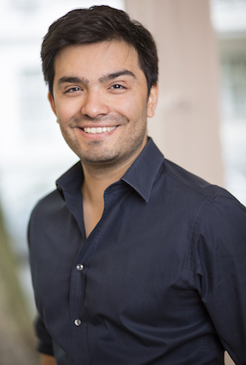
Big Data Management Group (BigDaMa)
Ziawasch
Abedjan
Mohammad
Mahdavi
Larysa
Visengeriyeva
Mahdi
Esmailoghli
Felix
Neutatz
Binger
Chen
Maximilian
Dohlus
Funding:
DFG
BMBF BMVI
Notes:
Research group
Add Mahdi?

Slide 3
BigDaMa Research
Data Integration
Data Discovery
Focus:
Variety of Big Data
Data Cleansing
Data Profiling
Notes:
Look at job description

Slide 4
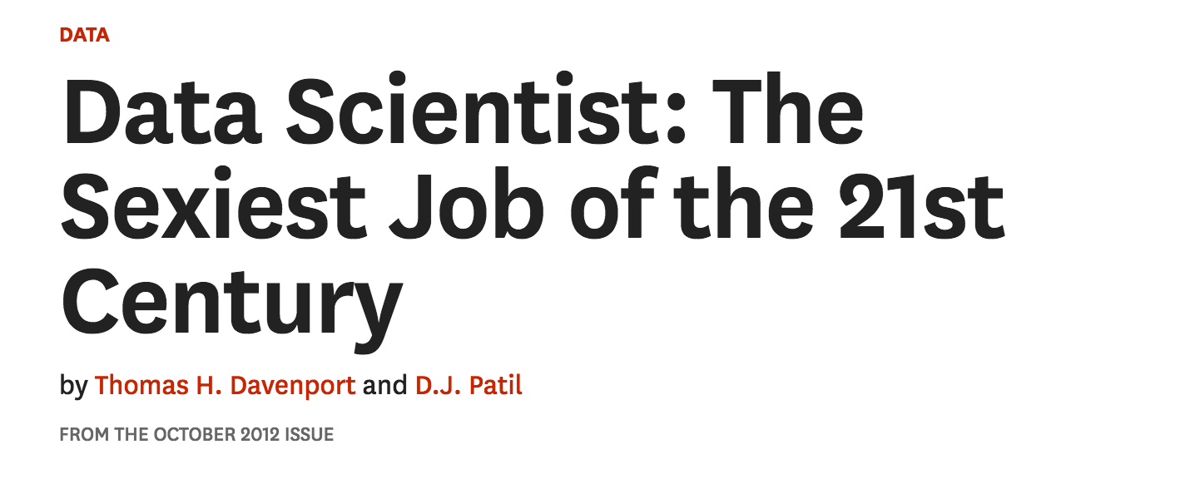
Emergence of Data Driven Applications
Big data: The next frontier for innovation, competition, and productivity
But, what do data scientists actually do?

Slide 5
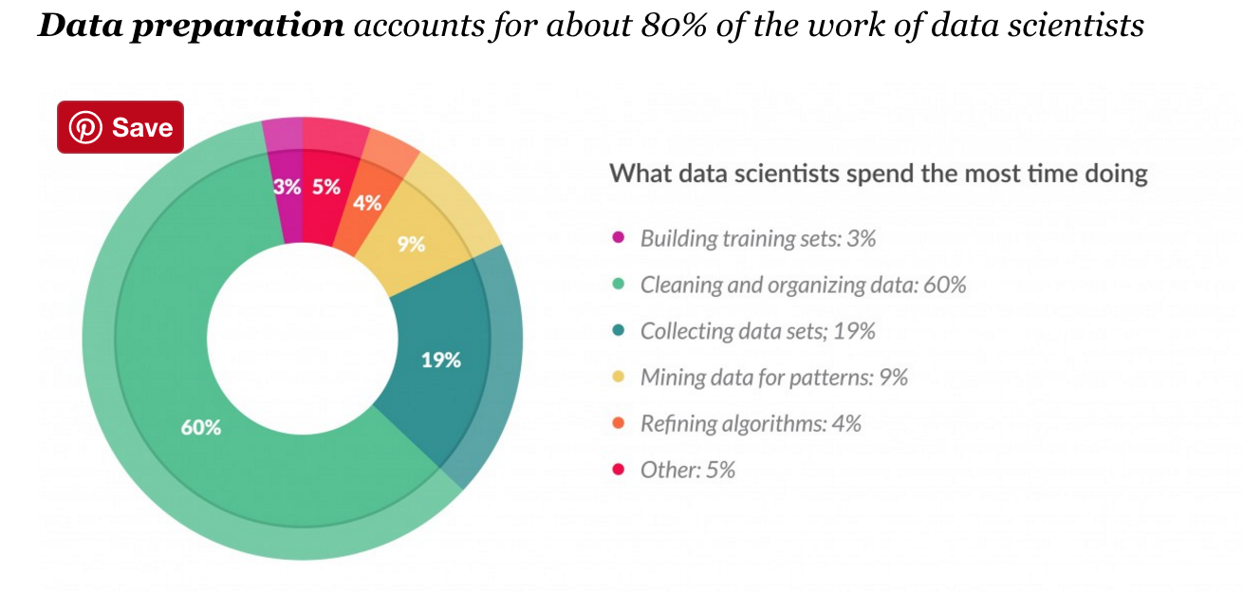
CrowdFlower’s Data Science Report 2016
“Cleaning Data: Most Time-Consuming, Least Enjoyable Data Science Task”, Gil Press, Forbes, March 23rd, 2016

Slide 6
Data Preparation is a Challenge
Data Preparation
Acquire Data
Storage
Wrangling
Cleaning
Error Detection
[Abedjan,2016]
[Li,2012]
[Fan,2012]
[Claudel,2016]
[Dallachiesa,2013]
[Kandel,2011]
Error Repair
80%
20%
6

Slide 7
What are Errors?
Representation
Contradiction
ID | Name | Birthday | Age | ZIP | Place
1234 | Felix Neutatz | 19.09.90 | 27 | 1234 | Berlin
1234 | Visengeryeva, Larysa | - | 00 | 1234 | Bärlin
1235 | Ziawasch | Abedjan | - | 12.34 | Germany
Uniqueness
Typo
Incorrect value
Column shift
Missing value

Slide 8
Challenges in Data Cleaning
Manual cleaning:
Infeasible on large datasets (Big Data)
Even the user does not anticipate and see all possible problems
Automatic algorithms (previous research):
Well-defined models
Not general enough to capture all possible data quality problems
If end-to-end: User has to know everything
Notes:
Offensichtlich brauchen wir einen Mittelweg
Manual Curation:
Infeasible on large datasets (Big Data)
Even the user does not anticipate all possible problems
Automatic algorithms (Previous Research):
Cannot capture all possible data quality problems
Very many algorithms exist for isolated sub-problems
Which ones to choose and in which order?
Require well-defined models for error detection, matching
Fail on exceptions in the wild
Requires the user to perform a top-down design of the integration workflow

Slide 9
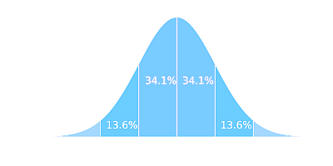
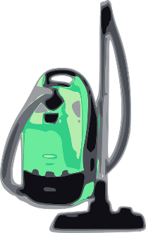
Error Detection Algorithms
Outlier Detector
Pattern Violation Detector
[\w\.-]+@[\w\.-]+
Rule Violation Detector
Same zip code → same city
Knowledge Base Violation Detector
Germany HasCapital Berlin

Slide 10
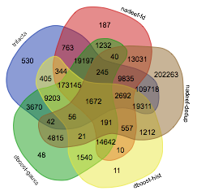
Aggregation of Error Detection Strategies [PVLDB’16, SSDBM’18]
rule violation
Datasets seldom contain only one issue: there is usually a mix of different problems (e.g. missing values and rules violations) [Arocena,2015]
Initial approach based on unsupervised aggregation: Union-All, Min-K, Precison-based Ordering [PVLDB’2016]
Supervised aggregation of tools tested in [SSDBM’18]
pattern violation
duplicate conflicts
outlier detection
(gaussian)
outlier detection
(histogram)
FLIGHTS Dataset
Notes:
Venn diagram erklären

Slide 11
Challenges in Error Detection
Algorithm Selection
Which algorithms should we run?
Algorithm Configuration
How should the selected algorithms be configured?
Running only one leads to poor recall.
Running all of them leads to poor precision. [PVLDB’16]
Learning the aggregation requires a lot of training data. [SSDBM’18]

Slide 12
Our take in 2019 …
REDS: Automated tool selection based on meta-learning [SSDBM’19]
ED2: Error detection as a active learning task [CIKM’19]
Raha: Forks both of the above [SIGMOD’19]
REDS: Automated tool selection based on meta-learning [SSDBM’19]
ED2: Error detection as a active learning task [CIKM’19]
Raha: Forks both of the above [SIGMOD’19]

Slide 13
Problem
Name | Profession | Age | City
Bruce Wayne | Billionaire | 127 | Gotham
Harvey Dent | District Attorney | 30 | Metropolis
Joker | Criminal | 35 | Gotham
Which tools are most effective in cleaning my dataset?

Slide 14
Human Involvement Cost
Running one Error Detection Tool
on the Dirty Dataset
Costly!
Name | Profession | Age | City
Bruce Wayne | Billionaire | 127 | Gotham
Harvey Dent | District Attorney | 30 | Metropolis
Joker | Criminal | 35 | Gotham
Evaluating the Output
Tool’s Performance
Tool’s Output
Name | Profession | Age | City
Bruce Wayne | Billionaire | 127 | Gotham
Harvey Dent | District Attorney | 30 | Metropolis
Joker | Criminal | 35 | Gotham
$$P=0.33$$
$$R=0.5$$
$$F1=0.4$$

Slide 15
Naïve Solution
Costly!
Name | Profession | Age | City
Bruce Wayne | Billionaire | 127 | Gotham
Harvey Dent | District Attorney | 30 | Metropolis
Joker | Criminal | 35 | Gotham
Name | Profession | Age | City
Bruce Wayne | Billionaire | 127 | Gotham
Harvey Dent | District Attorney | 30 | Metropolis
Joker | Criminal | 35 | Gotham
Evaluating the Output
Running all tools leads to too many false positives.

Slide 16
Idea
Name | Profession | Age | City
Bruce Wayne | Billionaire | 127 | Gotham
Harvey Dent | District Attorney | 30 | Metropolis
Joker | Criminal | 35 | Gotham
$$F1= ?$$
$$F1= ?$$
Tools will perform similarly on similarly dirty datasets.
Estimate the performances.
$$F1= ?$$

Slide 17
Problem Definition
Input | Output
$$F1= ?$$
Continuous Number
Dataset
Error Detection Tool
Regression makes sense…
But, how to engineer the feature vector?

Slide 18
REDS: Recommending Error Detection Strategies based on Dirtiness Profiles [SSDBM’19]
Feature Vector
=
Dirtiness Profile!
Content Profiler
Top Keywords
Structure Profiler
Quality Profiler
Normalized output size of tools
Normalized overlap of tools’ outputs
Size of dataset
Uniqueness, #of null values
String patterns ….

Slide 19
Experimental Setup
50 Training Datasets with
Known Ground Truths
A New Arriving
Dirty Dataset
Rank | Tool | F1
1 2 3 |  | 0.87 0.64 0.49
15 Error Detection Tools

Slide 20
Evaluation Measures
Rank | Tool | F1
1 2 3 |  | 0.87 0.64 0.49

Slide 21
Performance

Slide 22
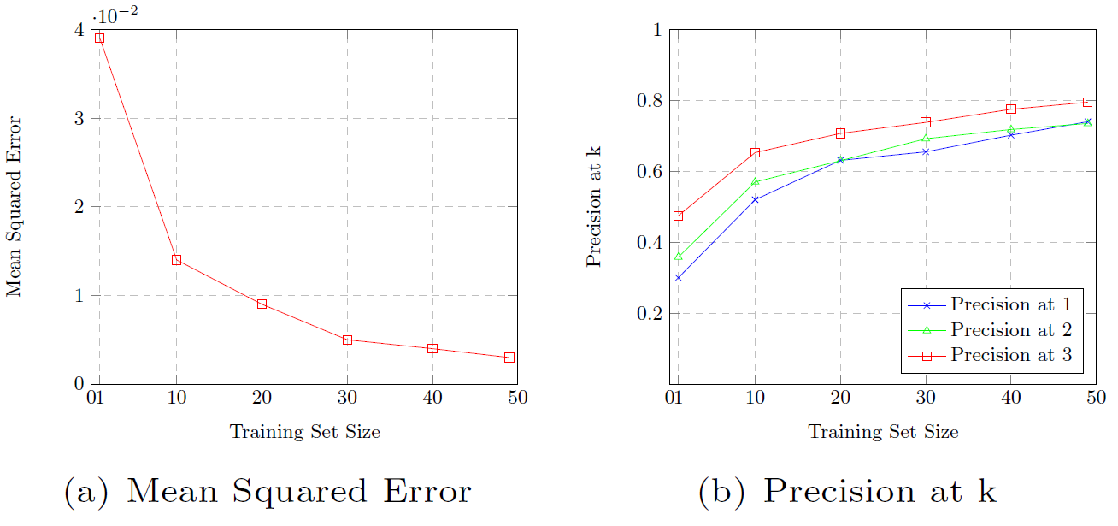
Training Set Size

Slide 23
Limitations of REDS [SSDBM’19]
Algorithms have to be configured manually
Approach gives us the most promising detector
But we claimed that anyway a combination is required
Granularity of tool performance per dataset is too restrictive
New proposal: Raha
Automatically combines many strategies and generates configurations
Uses historical data as filter criterion

Slide 24
Raha: Automatic Algorithm Configuration
Instead of finding the best algorithms/configurations,
use a wide range of algorithms/configurations
as similarity features for each data cell.
Configuration 1
Configuration 2
…
Configuration N
Configuration 1
Configuration 2
…
Configuration M
Algorithm 1
Algorithm 2
Error Detection Strategies =
|𝑨𝒍𝒈𝒐𝒓𝒊𝒕𝒉𝒎𝒔|×|𝑪𝒐𝒏𝒇𝒊𝒈𝒖𝒓𝒂𝒕𝒊𝒐𝒏𝒔|

Slide 25
Feature Vector Generation
$S_{1}$= Value is not alphabetical?
$S_{2}$= Is the length of value shorter than 6?
$S_{3}$= Does the value exist inside our knowledge base X?
1 = Yes
0 = No
City | $$s_{1}$$ | $$s_{2}$$ | $$s_{3}$$
Berlin | 0 | 0 | 1
Bärlin | 0 | 0 | 0
$$∅$$ | 1 | 1 | 0
999999 | 1 | 0 | 0
Paris | 0 | 1 | 1
Pariss | 0 | 0 | 0

Slide 26
Reducing Training Data By Grouping Similar Values into Groups
Pick samples from each cluster separately
City | $$s_{1}$$ | $$s_{2}$$ | $$s_{3}$$
Berlin | 0 | 0 | 1
Paris | 0 | 1 | 1
$$∅$$ | 1 | 1 | 0
999999 | 1 | 0 | 0
Bärlin | 0 | 0 | 0
Pariss | 0 | 0 | 0
City | $$s_{1}$$ | $$s_{2}$$ | $$s_{3}$$
Berlin | 0 | 0 | 1
Bärlin | 0 | 0 | 0
$$∅$$ | 1 | 1 | 0
999999 | 1 | 0 | 0
Paris | 0 | 1 | 1
Pariss | 0 | 0 | 0
Clean
Dirty
Cluster assumption: Two data points are likely to have the same class label if they belong to one cluster [7].

Slide 27
Label Propagation and Classification
City | $$s_{1}$$ | $$s_{2}$$ | $$s_{3}$$
Berlin | 0 | 0 | $$s_{3}$$
Paris | 0 | 1 | 1
$$∅$$ | 1 | 1 | 1
999999 | 1 | 0 | 0
Bärlin | 0 | 0 | 0
Pariss | 0 | 0 | 0
Clean
Clean
Label Propagation
Train and
classify
Dirty
Dirty
Dirty
Dirty

Slide 28
Iterative Tuple Selection
Hierarchical Clustering
Until the labeling budget is depleted:
Increase the number of clusters in each column (start with 2 per column)
Ask the user to label the tuple.
Draw a tuple that covers as many unlabeled clusters as possible across all columns.
Propagate labels and resolve labeling conflicts

Slide 29
Experimental Overview
8 Datasets
7 Baselines
dBoost [1]
5 Evaluation Measures
KATARA [3]
ActiveClean [4]
Min-k [5]
PBO [5]
MDED [6]
Runtime
Labeled Tuples
NADEEF [2]
Precision
Recall
$F_{1}$ Score
𝐹_1 Score
10+ Experiments
Performance
Features
Sampling
Strategy Filtering
User Labeling Error
Scalability
Classification Model
Hospital [8]
Flights [8]
Address
Beers [9]
Rayyan [10]
Movies [11]
IT [5]
Tax [12]

Slide 30
Comparison with the Baselines
Raha outperforms all the baselines
with fewer than 20 labeled tuples.

Slide 31
Error Correction and Data Transformation

Slide 32
Correcting Data is Magic
Automatic repair of errors:
Similarity join with a dictionary
Sophisticated probabilistic approaches
Truth discovery [Yin, Han, Yu. KDD’07]
Conflict resolution
Data Fusion [Bleiholder, Naumann. ACM Surveys’09]
Crowd-sourcing
CrowdER [Wang et al. PVLDB’12])
Semi-automatic:
User-defined transformation
Already hard enough!

Slide 33
Example-based Transformations
DataXFormer [CIDR’15,SIGMOD’15,ICDE’16]
Use Web sources to systematically transform columns into the correct format
Unsupervised String Transformation Learning [ICDE’19]
Use redundancy in data to generate transformation functions

Slide 34
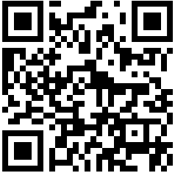
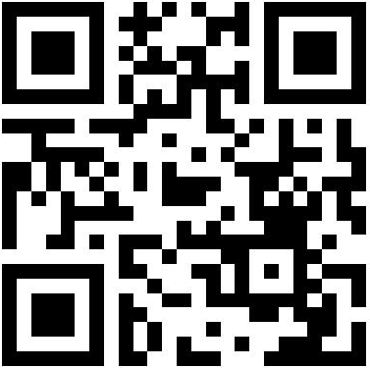
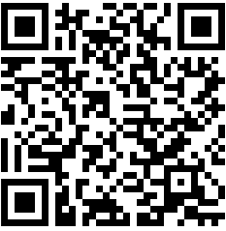
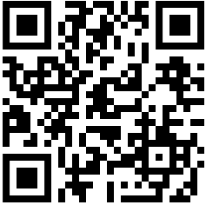
Wrap-UP
Error Detection: Raha and Reds
There is no single dominant tool.
Estimating the performance based on historical data is possible
User-involvement can be reduced meta-learning and clustering
MDED, a system that learns to aggregate error
detection strategies via metadata
Larysa Visengeriyeva et al.
SSDBM`18
REDS, a system that estimates the performance
of error detection strategies via metadata
Mohammad Mahdavi et al.
SSDBM`19
ED2, an active learning-driven error detection system
Felix Neutatz et al.
CIKM`19
Raha, a configuration-free error detection system to detect data errors holistically
Mohammad Mahdavi et al.
SIGMOD`19
http://bit.ly/systems-aggregation
https://github.com/bigdama/reds
http://bit.ly/2mjyiTO
https://github.com/BigDaMa/raha

Slide 35
References
[1] | Clement Pit-Claudel et al. 2016. Outlier detection in heterogeneous datasets using automatic tuple expansion. Technical Report MIT-CSAIL-TR-2016-002. CSAIL, MIT.
[2] | Michele Dallachiesa et al. 2013. NADEEF: a commodity data cleaning system. In SIGMOD. 541–552.
[3] | Xu Chu et al. 2015. Katara: A data cleaning system powered by knowledge bases and crowdsourcing. In SIGMOD. 1247–1261.
[4] | Sanjay Krishnan et al. 2016. Activeclean: Interactive data cleaning for statistical modeling. PVLDB 9, 12, 948–959.
[5] | Ziawasch Abedjan et al. 2016. Detecting data errors: Where are we and what needs to be done? PVLDB 9, 12, 993–1004.
[6] | Larysa Visengeriyeva and Ziawasch Abedjan. 2018. Metadata-driven error detection. In SSDBM. 1–12.
[7] | Olivier Chapelle et al. 2003. Cluster kernels for semi-supervised learning. In NIPS. 601–608.
[8] | Theodoros Rekatsinas et al. 2017. Holoclean: Holistic data repairs with probabilistic inference. PVLDB10, 11, 1190–1201.
[9] | Jean-Nicholas Hould. 2017. Craft Beers Dataset. https://www.kaggle.com/nickhould/craft-cans. Version 1.
[10] | Mourad Ouzzani et al. 2016. Rayyan—a web and mobile app for systematic reviews. Systematic reviews 5, 1, 210.
[11] | Sanjib Das et al. 2015. The Magellan Data Repository. https://sites.google.com/site/anhaidgroup/projects/data.
[12] | Patricia C Arocena et al. 2015. Messing up with BART: error generation for evaluating data-cleaning algorithms. PVLDB9, 2, 36–47.

